Slide 1
Introduction to the ODA-CA project & tmf.codes

Slide 2

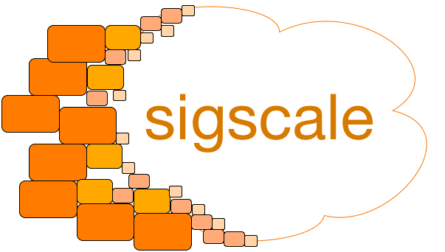









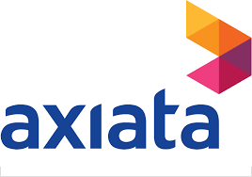

ODA Component Accelerator Project (ODA-CA)
Initiated in December 2020 with 11 founding members (announcement here)
“The ODA Component Accelerator provides a much-needed neutral sandbox environment where CSPs and solutions suppliers alike can come together and work to build the market for software components” Carlos Valero, Global Director of IT Strategy and Architecture, Vodafone
Mission: to accelerate standardization of ODA components through:
Collaborative development of the ODA Canvas and other non-commercial software code using an opensource approach*
Developing tools & processes for validating ODA Component conformance (including the Component CTK)
Establishing the ODA Reference Implementation
Testing and validating the ODA component specifications and Reference Implementation against real-world commercial products
Preparing the ground for ODA component interoperability testing
* The purpose is not to build open-source OSS/BSS but to create an open-source platform for ODA component validation and interoperability testing of commercial software products

Slide 3
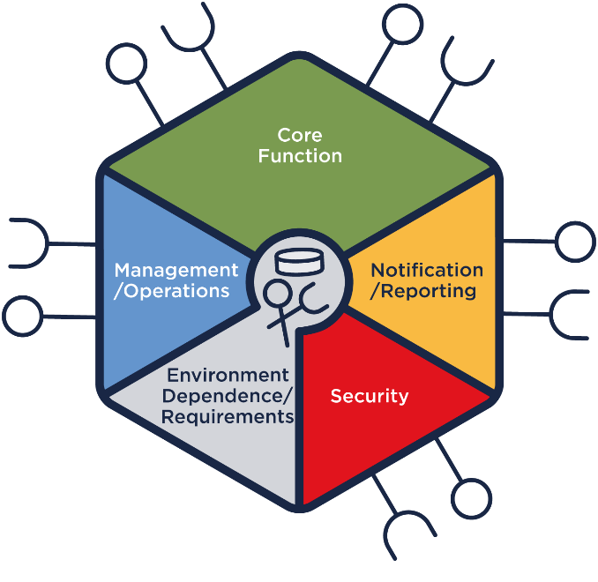
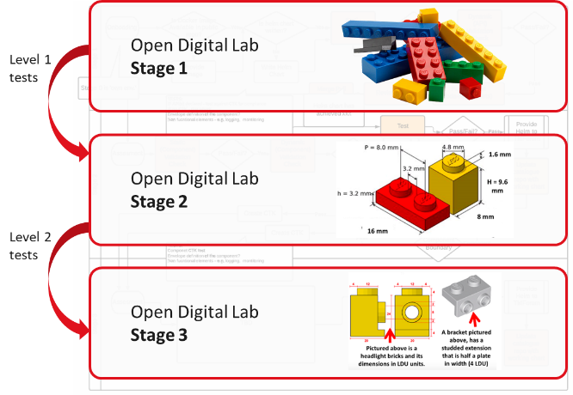










ODA-CA Deliverables
Collaborative development of the ODA Canvas
Delivered an execution environment for ODA reference implementations based on standard Kubernetes infrastructure
Building a ‘click-to-deploy’ reference Canvas for members to use
Demonstrated deployment patterns for security and observability use cases
Easy onboarding of vendor applications and validation against the ODA design
Delivered a Component CTK which validates security and functional aspects of ODA Components; established a 3-stage test platform in the Open Digital Lab
Working on a comprehensive BDD-based test approach to prove 'ODA by design’
Building a test platform for ODA Components
Establishing ODA Reference Implementation(s)
ODA-CA member companies are contributing their components
Accelerating the ODA standards
Mapping ODA Component definitions to real-world commercial products, validating the standards as they are being created
See documentation here for the latest information

Slide 4




Where are we? Iterative top-down and bottom-up delivery
We are here
ODA Component Marketplace
‘AWS style’ marketplace of independently deployable components
Ability to rapidly prototype PoCs
First Standardized Component
Component Certification
Product Catalog as first ODA ‘Golden Component’
Landscaped using TMF reference architecture:
eTOM & SID Entities & TMF Open-APIs
TM Forum certification of software components
Open Digital Lab for industry PoCs
Crowd-source component map
Automated testing
Crowd-source candidate components
Analyze fit to ODA and publish ‘heatmap’ of components
Compliance Test Kit (CTK) automatically tests compliance
Against Golden Components. Multiple API gateways demonstrate modularity of Canvas
Principles and Taxonomy
Secure-by-design
Develop principles to define ODA Component
Develop taxonomy to map to ODA Functional Blocks
Keycloak as example IAM solution Security meta-data built into Component Envelope
Example components implementing Security standard
Build baseline Open Digital Lab platform
Open Digital Lab Kubernetes environments
Initial Canvas from BOS Catalyst
Initial components deployed

Slide 5
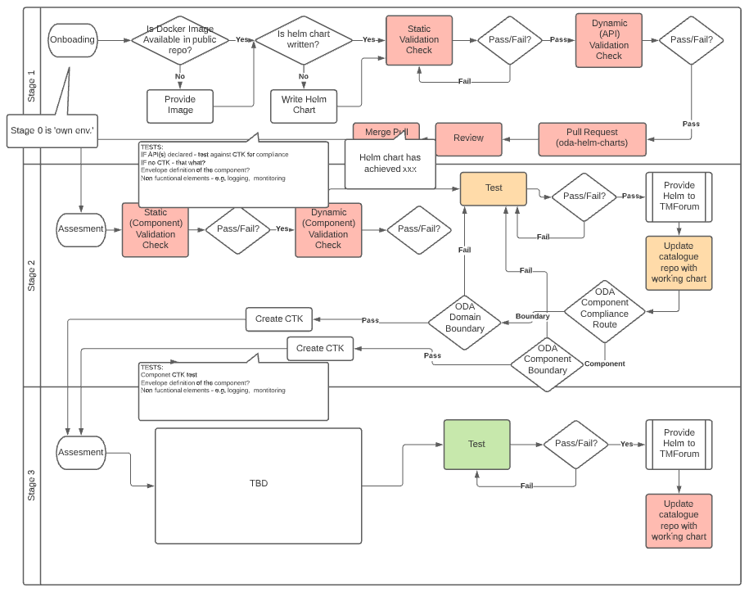
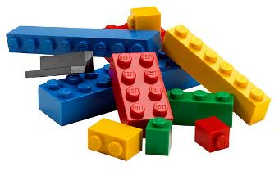
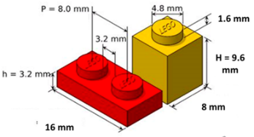
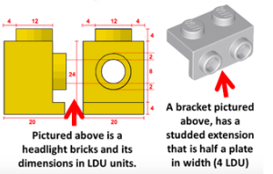
Automated Compliance Testing for ODA Components
Stage 1
A catalog of “Candidate Components”
Stage 2
Validation of Components for compliance with generic ODA design guidelines
Stage 3
Validation of specific ODA Components (eg Product Catalog…) vs mandatory scope of ‘Golden Component’ specs
Open Digital Lab Stage 1
Level 1 tests
Open Digital Lab Stage 2
Level 2 tests
Open Digital Lab Stage 3

Slide 6
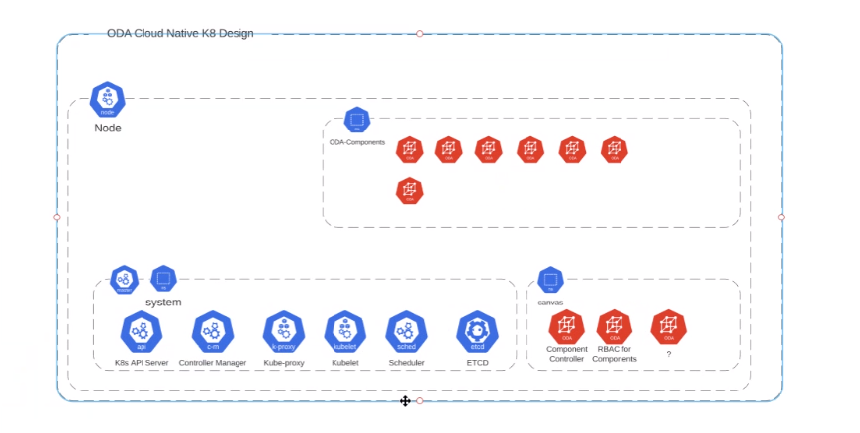


ODA Reference Implementation in the Open Digital Lab
ODA Functional Components
Canvas
Canvas Services (non-functional)
System

Slide 7
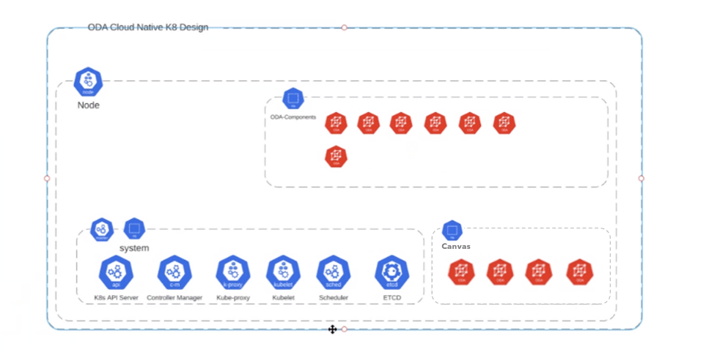
ODA Reference Implementation in the Open Digital Lab
Canvas
canvas-system
service-mesh-system*
Component Controller
Service Mesh (eg Istio)
Security Controller
Observability (eg Kiali)
API Controller
monitoring-system*
Canvas Services (non-functional)
Component CRD Webhook
Monitoring (eg Prometheus)
Visualization (eg Grafana)
api-gateway-system*
iam-system*
API Gateway (eg Whale Cloud, Apigate…)
Identity & Access (eg Keycloak)
Choice of implementation
Standard Canvas service
*namespace name may very depending on implementation

Slide 8
Work plan for Phase 5 (Dec 2022 to May 2023)
Canvas Services track* (documented here)
Create MVP of ODA Canvas use case library and BDD
Add these use cases to the prototype ODA Canvas CTK
Components track
Publish v1beta1 Component CTK aligned with the beta1 Component specification (full spec with BDD)
Use the CTK to test commercial Product Catalog components, including BDD for the Canvas supporting functions
Create test tooling to semi-automate the CTK validation of components deployed on the reference Canvas
Event Hub processing
Introduce an TMFC019 Event Management component for the ODA and build an Operator using the YAML descriptor of components to set up event flows
Onboarding
Update the onboarding playbook on GitHub for new project members and interested observers
Incorporate the latest materials (eg demos and presentations from DTW 2022)

Slide 9
ODA-CA project vs other TM Forum projects
TM Forum
tmf.codes
tmf.codes Projects
ODA-CA
Licensing: Apache 2.0
Collaboration Projects
Catalyst Projects
TM Forum Projects
TM Forum Services
Legal
Open Digital Lab (ODL)
PMO
etc.

Slide 10
Detailed Concepts
Legal entity | tmf.codes
Licensing of output | Apache 2.0
Legal sign-up | ODA-CA contract with tmf.codes; contributor license agreements
ODL | Dedicated development environment for code-sharing (eg for building the ODA Canvas) and runtime environment for testing, CTK development etc
Participation | Any TM Forum member can join at any time Entry criteria include signing the Open API & Open Digital Architecture Manifesto and committing resources Fees are payable (see commercial model)
Standards | ODA-CA cannot develop standards, but instead makes contributions to the ODA Collaboration Project (see here)
Commercial model | One-time fee for access to each phase of the project and ODL seats ODA-CA members get full access to the Open Digital Lab environments for development and testing, and can sponsor / donate seats for other TM Forum members to use
Governance | The work of ODA-CA is decided by ODA-CA members using a standard opensource approach A Steering Committee acts as an advisory board

Slide 11
ODA-CA is an Accelerator Project
 | Collaboration | Catalyst | Pioneer | Accelerator
Membership | Open | Private | Semi-private | Limited / Semi-private
Minimum companies participating | 4 | 1 Champion + 4 Participants | 4 | N (>=1) sponsor companies For ODL, M (>=4) developers
Fees | No | Fixed fee for vendor participants | No | Fees paid by all participants
Time limit | Ongoing | 1 Catalyst cycle | 1 year | Yes
Must have a Project Charter | Yes | Yes | Yes | Yes
Output | TM Forum Standards | Catalyst demonstration & collaboration contributions | Pioneer Report & collaboration contributions | Collaboration contributions, software code…
Can create TMF standards | Yes | No | No | No
Consensus | Takes all views, builds consensus, based on team approval | Only Catalyst team members | Anyone may inject input, but Founder Pioneers may defer input | Project governed by a Steering Committee &/or opensource methods
Included collaboration services | IPR boundary; Collaboration space; PMO support; CurateFx | IPR boundary; Collaboration space; PMO support; Matchmaking; SME support; CurateFx; Lab | IPR boundary; Collaboration space; PMO support; Matchmaking; SME support | IPR boundary (including tmf.codes); ODL seats; Collaboration space; PMO support; Matchmaking
Fee-based collaboration services | SME support |  |  | TMF expert consulting; CurateFx
Included marketing services | None | Inform articles; Videos; Event showcase; Awards | None | None
Fee-based marketing services | Inform articles; Videos; Webinars | Webinars | Inform articles; Videos; Webinars | Inform articles; Videos; Webinars; Event showcases…

Slide 12
ODA Project relationships
Creates API specifications
Builds API reference implementations
Develops API CTK (Conformance Test Kits)
Open API Project
Defines the loosely coupled domains
Maintains eTOM, SID, Functional Framework
Information Systems Architecture Project
Develops the Component CTK
Builds a test environment for validating ODA Components
Develops the ODA Canvas and Reference Implementation(s)
Checks that the ODA Component specs are realizable in real-world commercial products
ODA-CA Project
Standards
ODA Technical Architecture & Components Project
Defines what an ODA Component is
Creates the catalog of ODA Components
Writes specifications for ODA Components (“Golden Components”)
Contributions and feedback
ODA-CA does not develop standards or define compliance rules, but instead makes contributions to the ODA Collaboration project

Slide 13
Benefits
All ODA-CA Project members receive the following
Dedicated development & runtime environments in the Open Digital Lab shared by project members
User seats for the Open Digital Lab (number of seats depends on tier level, see fees)
ODL seats can be allocated to member’s own staff, or 'sponsored’ to developers from a second TM Forum member company (sponsored seats may be reclaimed by the sponsoring company with 2 weeks’ notice)
ODL seats are transferable between staff working on ODA-CA, but not transferable to any other (future) Projects on ODL
Participation in the ODA-CA Project Steering Committee
Participation in TM Forum marketing activities around ODA-CA

Slide 14
Why Join ODA-CA?
Join the ODA-CA project to help build the test environment and CTK for ODA components, to jointly develop the ODA Canvas and populate the ODA Reference Implementation with real-world software components, and to establish best practices for ODA deployment
Influence the direction of important new ODA standards
Increase your team’s knowledge and expertise with ODA while developing practical tools and code
Gain recognition for industry leadership

Slide 15
Steps to formally join ODA-CA
Confirm your participation
Confirm your company’s participation tier
Provide contact details of the relevant person to receive the ODA-CA contract
Provide contact details of the relevant person to receive the invoice
Review, sign and return the legal document(s)
ODA-CA participants sign a commercial agreement and the Company Contributor License Agreement (CCLA)
Send us a list of developers to be provided with a login on ODL
Each developer will be asked to sign the Individual Contributor License Agreements (ICLA)
Get started
Use this onboarding checklist

Slide 16
Participation Fees for ODA-CA
Subscription Tier | Phase Price (6 mo) | Phase Price/mo | ODL Seats
A | $9,600 | $1,600 | 8
B | $7,200 | $1,200 | 6
C | $4,800 | $800 | 4
Other | $2,400 | $400 | 2
Example: a Tier B participant joining in Feb-23 pays $4,800 for the remaining 4 months of Phase 5 to the end of May-23 (= 4 x $1,200)
Companies must join the ODA-CA Project at their own Subscription Tier or above
eg a TM Forum Corporate B member must purchase a Tier B subscription (or a Tier A subscription)
New participants pay a one-off fee for the remaining duration of the current Phase of the project at the time of joining
Any TM Forum member organization may join at any time
The fee is the monthly price for the relevant subscription tier multiplied by the number of whole or part months remaining until the end of the current Phase
Companies may choose to drop out at the end of a Phase
The subscription fee buys ODL Seats for the duration of the relevant Phase of the ODA-CA Project
ODL seats are transferable between staff working on ODA-CA, but are not transferable to any other (future) Projects on ODL
ODL Seat allocations
Members may allocate their ODL seats to their own staff, or 'sponsor' one or more developers from a second TM Forum member company
In the latter case, the second company does not receive formal membership of the ODA-CA project
The sponsored company must independently sign the relevant tmf.codes legal agreements
Sponsored seats may be reclaimed by the sponsoring company with 2 weeks’ notice
Prices shown above are for Phase 5
Prices may change for subsequent Phases, but TM Forum will give a minimum of 3 months’ notice

Slide 17
Open Digital Architecture

Slide 18
Open Digital Architecture: a Change in Mindset
Traditional Architecture
Open Digital Architecture
Zero-touch Partnering
CSP domain
Digital SP domain
Partner domains
Operations (processes & people)
AI-Enabled, Real-Time Operations
Zero-touch Operations
BSS
Cloud Native IT & Network Components
Zero-touch Interoperability
OSS
Autonomous Infrastructure
Network (physical)
1
ENABLE PLUG-AND-PLAY IT & NETWORKS
2
MAKE ZERO-TOUCH OPERATIONS A REALITY
3
UNLEASH GROWTH BEYOND CONNECTIVITY
Notes:
A complete enterprise architecture blueprint for open digital platforms, replacing traditional OSS & BSS
Transforms business agility with simpler IT solutions that are easier and cheaper to deploy, integrate & upgrade
Comprises reusable, cloud native software components organized into loosely coupled domains
Components connect via standardized Open APIs which:
Provide zero-touch interoperability (plug-&-play components)
Expose business capabilities for zero-touch partnering
Built by industry agreement
TM Forum members are actively developing the ODA standards, leveraging mature, proven TM Forum assets

Slide 19
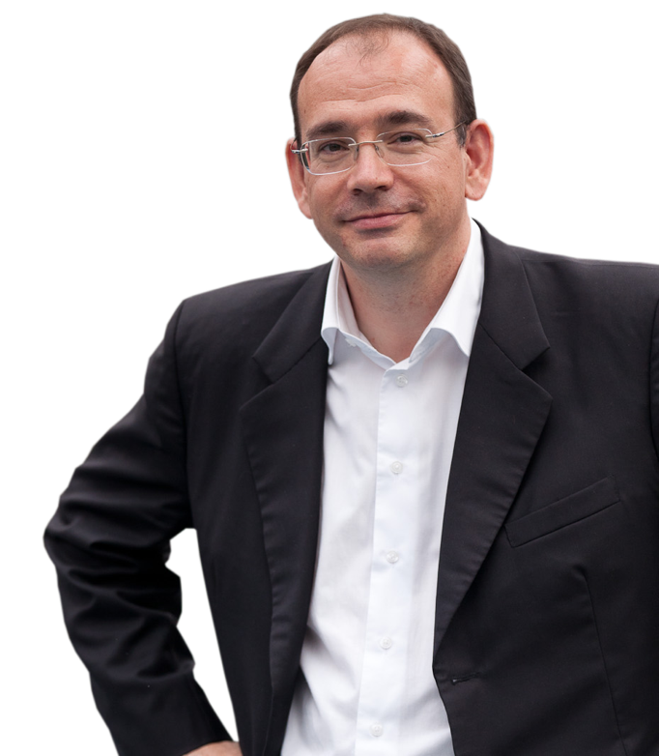
Open Digital Architecture (ODA)
“Open Digital Architecture is a
catalyst to cultural change.” Thierry Souche
Group CIO, Orange
A complete enterprise architecture blueprint for open digital platforms, replacing traditional OSS & BSS
Transforms business agility with simpler IT solutions that are easier and cheaper to deploy, integrate & upgrade
Comprises reusable, cloud native software components organized into loosely coupled domains
Components connect via standardized Open APIs which:
Provide zero-touch interoperability (plug-&-play components)
Expose business capabilities for zero-touch partnering
Built by industry agreement
TM Forum members are actively developing the ODA standards, leveraging mature, proven TM Forum assets

Slide 20
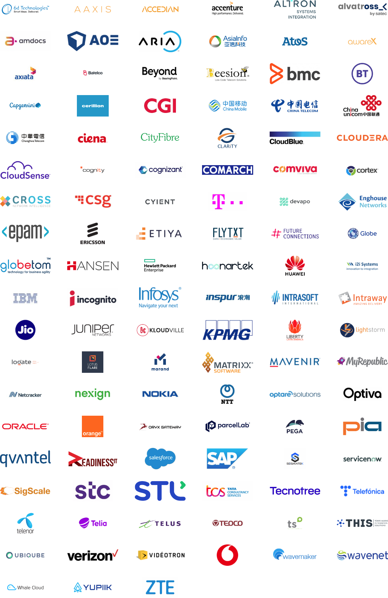
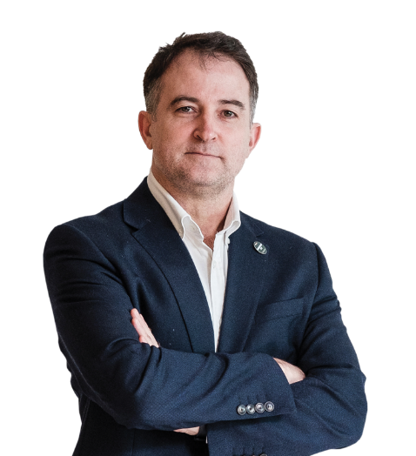
111 ODA Manifesto signatories
“Concepts like Open APIs, artificial intelligence, platform business models, and digital ecosystems will help drive agility and innovation. The TM Forum Open Digital Architecture provides a pragmatic way to bring these concepts together and sets the blueprint for digital transformation.”
Lester Thomas Chief IT Systems Architect, Vodafone

Slide 21
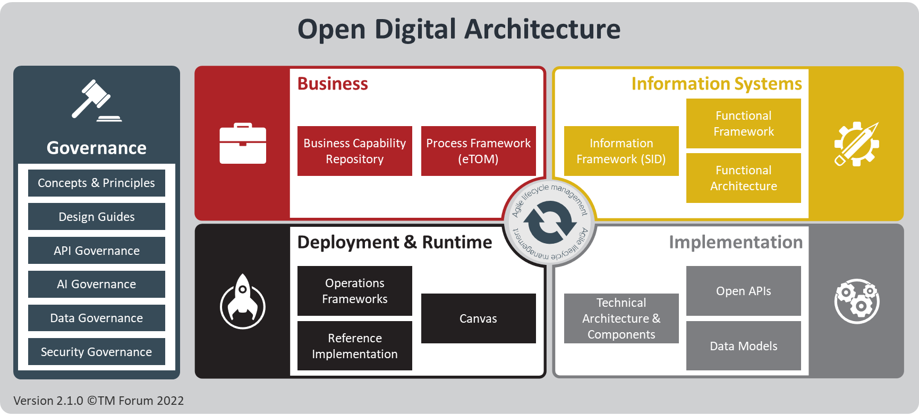
Structure of ODA
Business Architecture
Business capability map & value stream mappings
Multi-layered model of the key business processes for efficient, agile operations (eTOM)
Systems Architecture
Functional architecture (a set of structured and simplified implementation independent views enforcing decoupling)
Data architecture, with standard definitions for the information that flows through the enterprise and between service providers & their partners (SID)
Implementation Architecture
Suite of 50+ REST-based Open APIs for standardized interoperability of IT systems and partner integration
Definition of the ODA Components for reuse and simple integration
Standardized data model, enhanced for AI operations
Deployment & Runtime Environment
Canvas – a standard technical framework and DevOps environment for plug-and-play ODA components
Lab-deployed reference implementation and test environment
Governance
Principles, design guides, metamodels
Tools for agile management of the architecture lifecycle

Slide 22
ODA Key Benefits for the Industry
Ambition | Today’s Challenges | ODA Solutions
Accelerate Concept-to-Cash Launch new products in days | Lack of business agility | Modular, reusable software components Designed for rapid experimentation and agile ways of working
Monetize 5G in the enterprise 40% growth in B2B2X | Lack of business / technical alignment Systems & processes designed for traditional telco business | Common language for business & technology domains Supports any product via catalog-based data and rules Zero-Touch Partnering via Open APIs
Eliminate costs Double OpEx efficiency | High IT procurement & integration costs High maintenance cost of customized IT High operational cost of complex, manual processes | Enables a marketplace for standardized software components Open standards to minimize software customization Zero-Touch Interoperability via Open APIs Optimized for cloud native deployment Zero-Touch Operations via AI-enabled automation
Delight Customers 100% digital interactions | Poor customer experience due to disconnected systems No single view of the customer | Pace-layering for rapid evolution of customer-facing systems 360º customer view built on a common data model AI-ready for optimizing personalized customer experiences

Slide 23
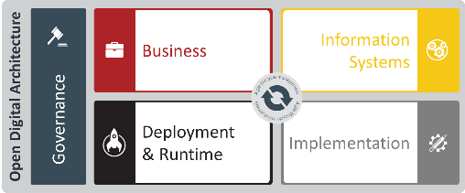
Migration to ODA
Traditional CSP
Typical Migration Architecture
Digital Service Provider
CSP domain
CSP domain
Zero-touch Partnering
Party Management
Digital SP domain
Partner domains
Operations (processes & people)
AI-Enabled, Real-Time Operations Augmented Intelligence
BSS
Decoupling and Integration
Cloud Native IT Production Components Re-usable, ‘Plug and Play’, Micro-service oriented
Engagement Management
Core Commerce Management
Intelligence Management
Zero-touch Interoperability
OSS
(Open APIs)
Network (physical)
Production Domain
Autonomous Infrastructure 5G + Edge + Data + AI
This is the starting position for most service providers. At this stage, the business architecture and information systems architecture is most relevant for governing changes to the existing landscape. And the transformation guides can be used to define your transformation strategy.
A typical first step is to wrap the existing systems in Open APIs to introduce loose coupling and to lay the foundation for agile transformation. In addition to the business architecture and information systems architecture; the Implementation architecture now become relevant for the Open APIs.
The final stage is the introduction of cloud native components. These will include components from partners. The whole of ODA is now relevant to define the business and information systems architecture and also the implementation and deployment architecture.
Business
Information Systems
Business
Information Systems
Business
Information Systems
Implementation
Deployment & Runtime
Implementation
Transformation Continuum
It is important to note that at any point in time some parts of the landscape may be in stage one, while others will be in stage two or even three. Therefore, the appropriate ODA guidelines should be applied to the appropriate parts of the landscape.

Slide 24





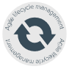
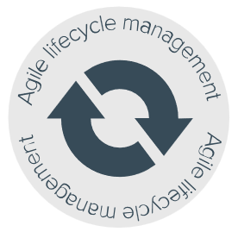




ODA Collaboration Project Mapping
Business Architecture
Information Systems Arch.
Open Digital Architecture
Governance
Business
Information Systems
End to End ODA Projects
Functional Framework
Business Capability Repository
Process Framework (eTOM)
Information Framework (SID)
Business Capabilities
Process Framework
Function Framework
Functional Architecture
Concepts & Principles
Information Framework
Design Guides
API Governance
Deployment & Runtime
Implementation
API Map
AI Governance
Operations Frameworks
Open APIs
Data Governance
Canvas
Technical Architecture & Components
Reference Implementation
Data Models
Security Governance
Component Map
Data Model
AI & Data
ODA Component Accelerator*
Tech Architecture & Components
Open APIs
Note: ODA CA is not a collaboration project, it is an accelerator project.

Slide 25
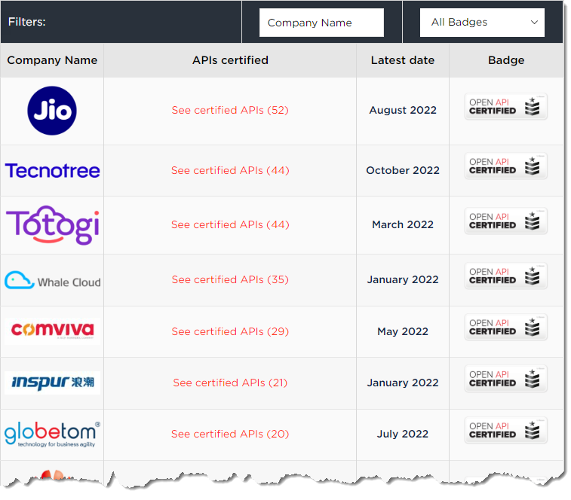
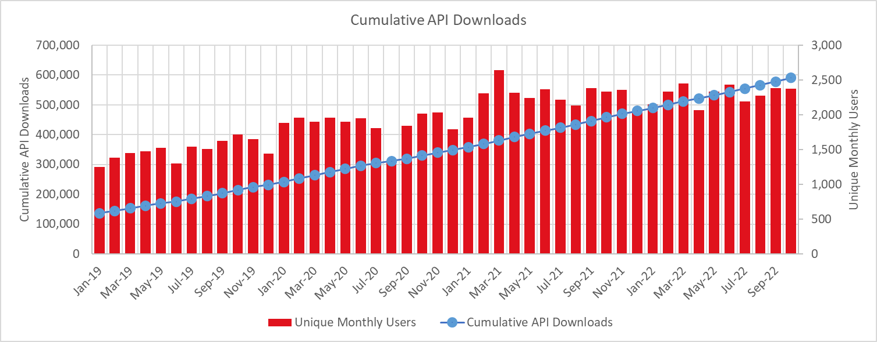
Increasing Open API adoption
With adoption growing year on year, join the movement with confidence
Over 590,000+ API downloads
by 36,000+ software engineers
from more than 2,500+ unique organizations
52 organizations have certified 501 Open APIs

Slide 26

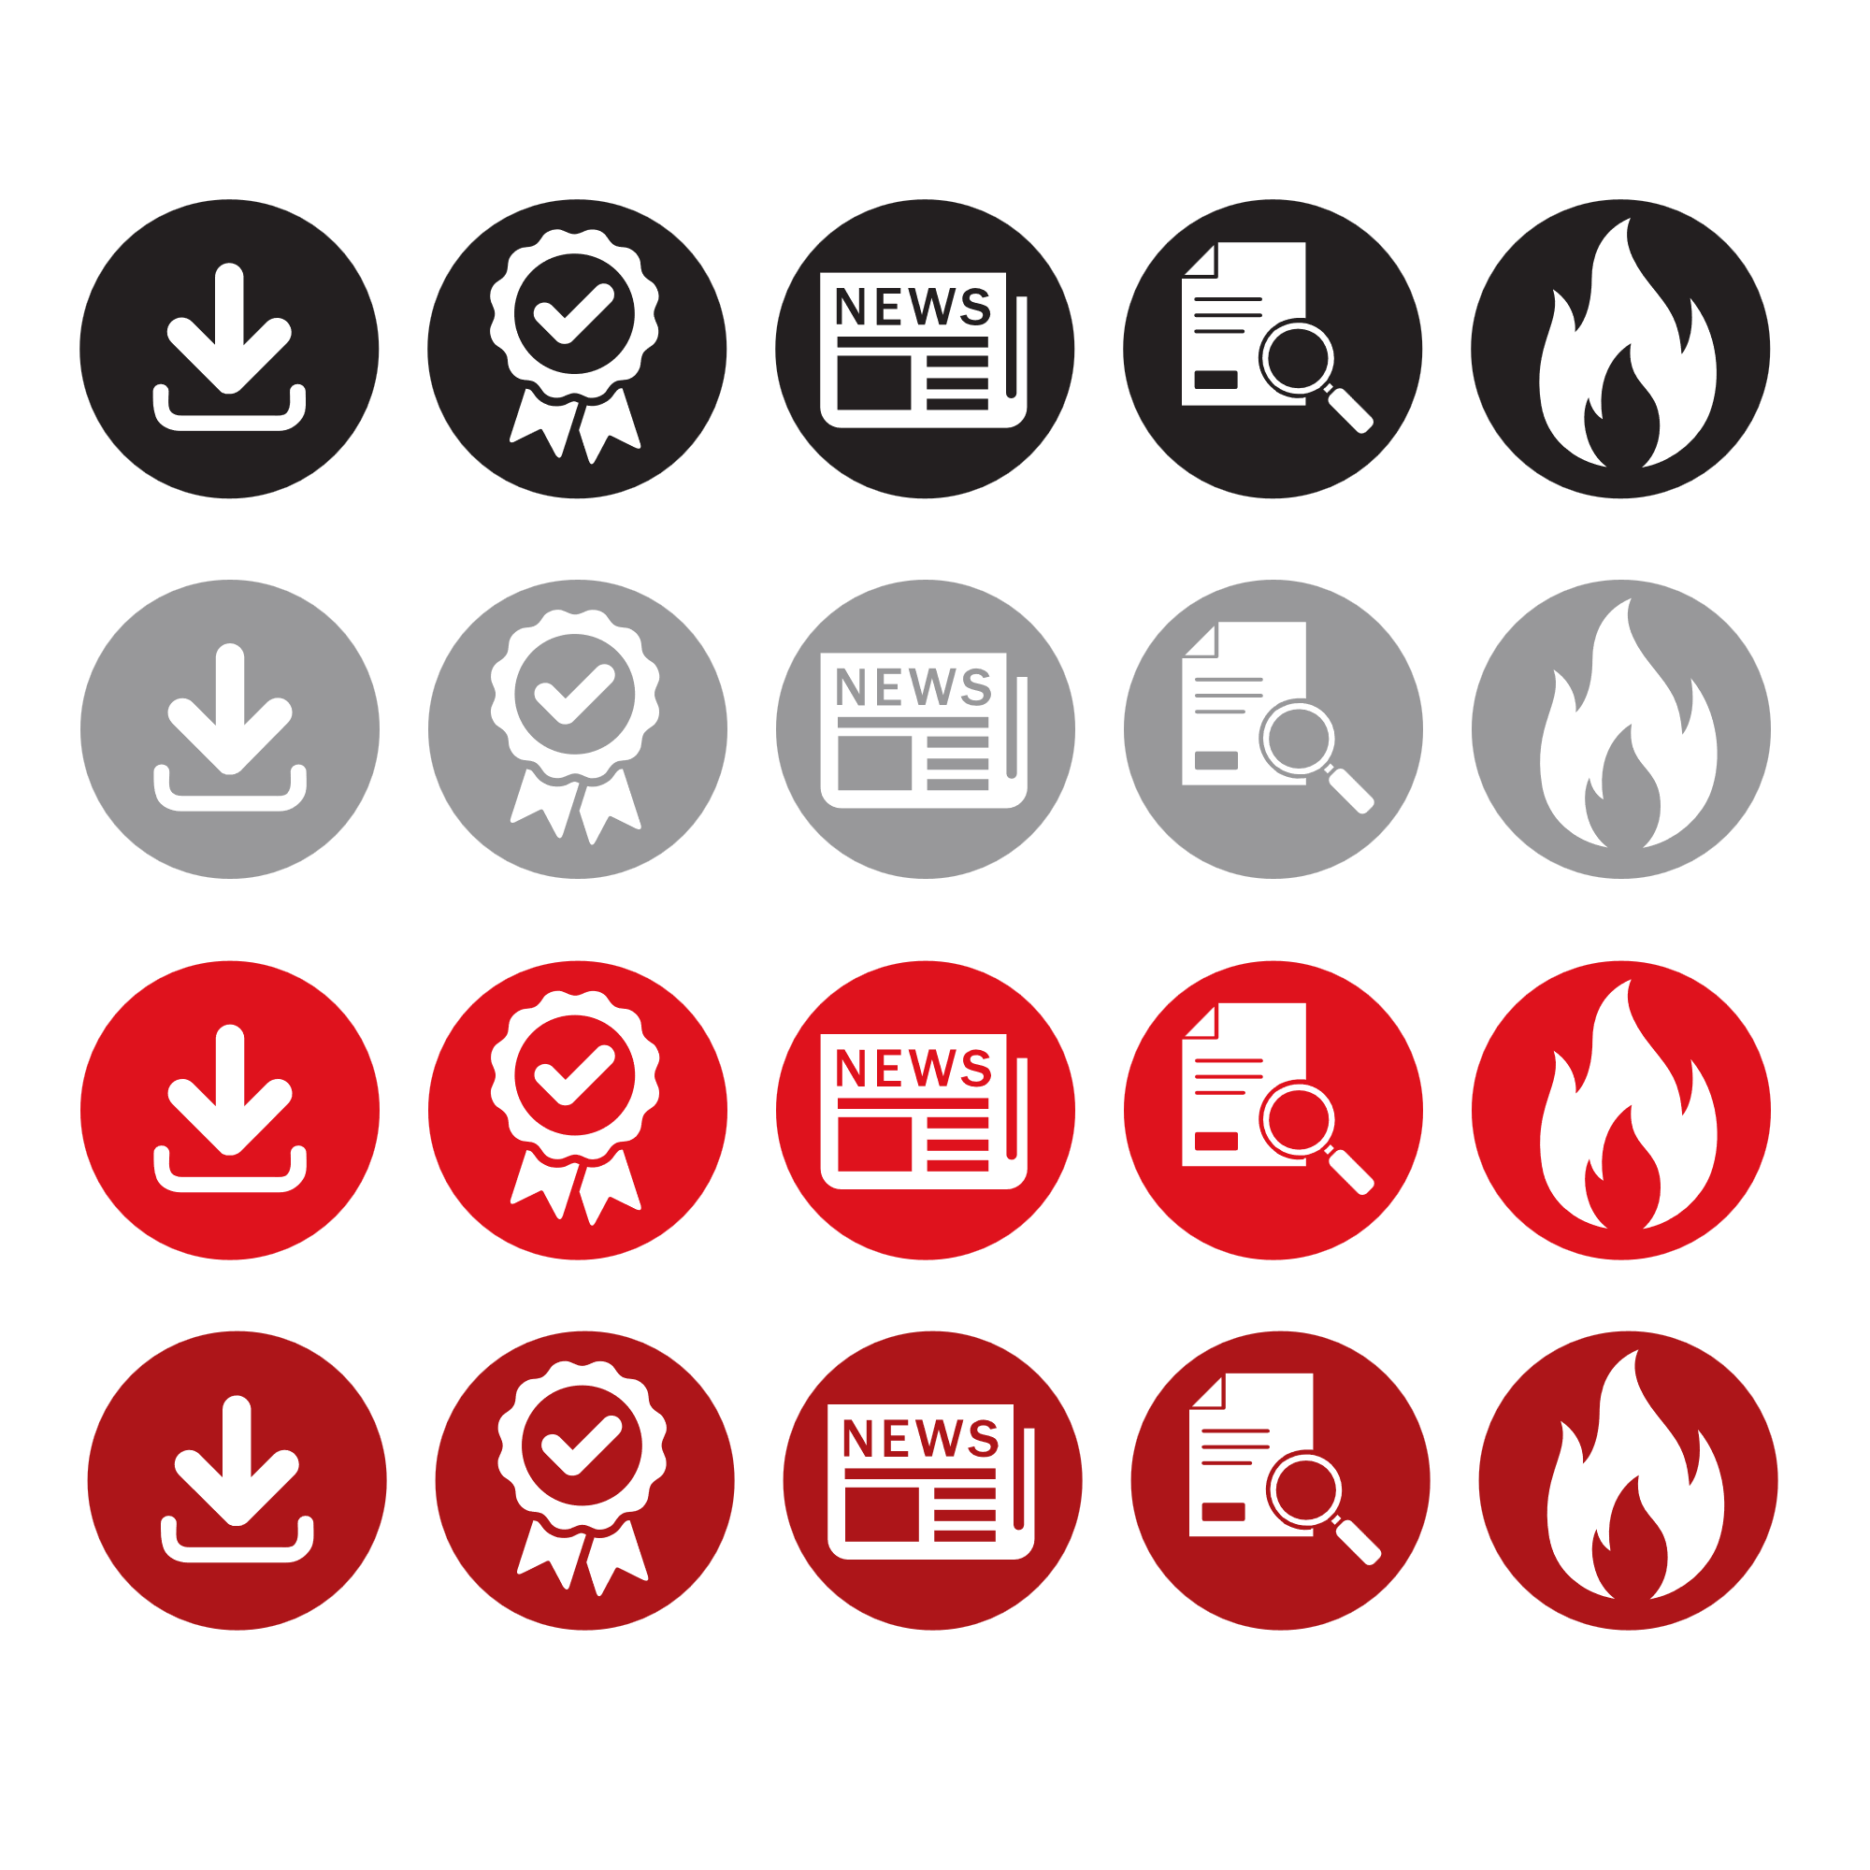
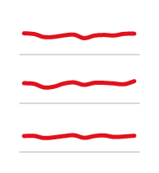








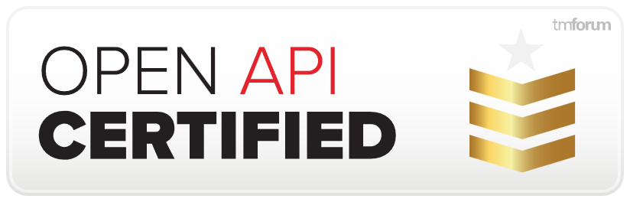

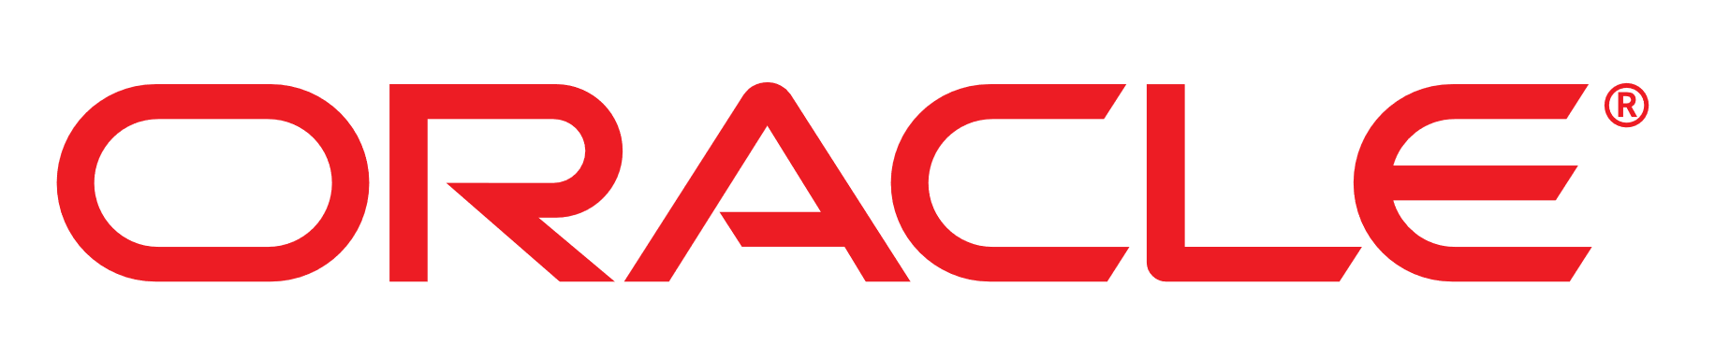










Open API dashboard for October 2022 All time totals: 590,383 Open API downloads by 36,838 developers from 2,501 organizations | 52 Organizations have certified 501 Open APIs
DOWNLOADS THIS MONTH
CERTIFICATIONS
WHAT’S NEW
API downloads 12,530
Unique organizations 442
Unique individuals 2,375
OPEN API CERTIFICATION LEADERBOARD
LATEST API UPDATES APPROVED
52
44
44
V5 TMF620 Product Catalog Mgt
TMF621 Trouble Ticket Mgt
TMF622 Product Ordering Mgt
TMF674 Geographic Site Mgt
V4: TMF653 Service Test
TMF921 Intent
35
29
21
20
TOP DOWNLOADERS*
Rank Organization Downloads
17
16
15
14
14
11
11
THIS MONTH’S MOST POPULAR APIs
11
11
10
10
Rank Change API name Downloads
TOP APIs CERTIFIED
API # Certifications
LATEST OPEN API CERTIFICATIONS
NEW API RESEARCH & CASE STUDIES
TM Forum certifies 500th Open API
Orange's CTO spells out need for network API collaboration
Industry reaches tipping point on TM Forum Open API Conformance
Taking integration to the next level Pieter Pabst, CTO Network Software, STL
Accelerating integrations with a common language Edgar Bautista, Solution Architect at Thinkskink
* Organizations with 5+ unique users in the month
Useful links
Open API table | Pre-production API table | 141 Open API manifesto signatories (current TM Forum members)
Contact: OpenAPI@tmforum.org
https://www.tmforum.org/open-apis/

Slide 27
ODA Components & Canvas

Slide 28
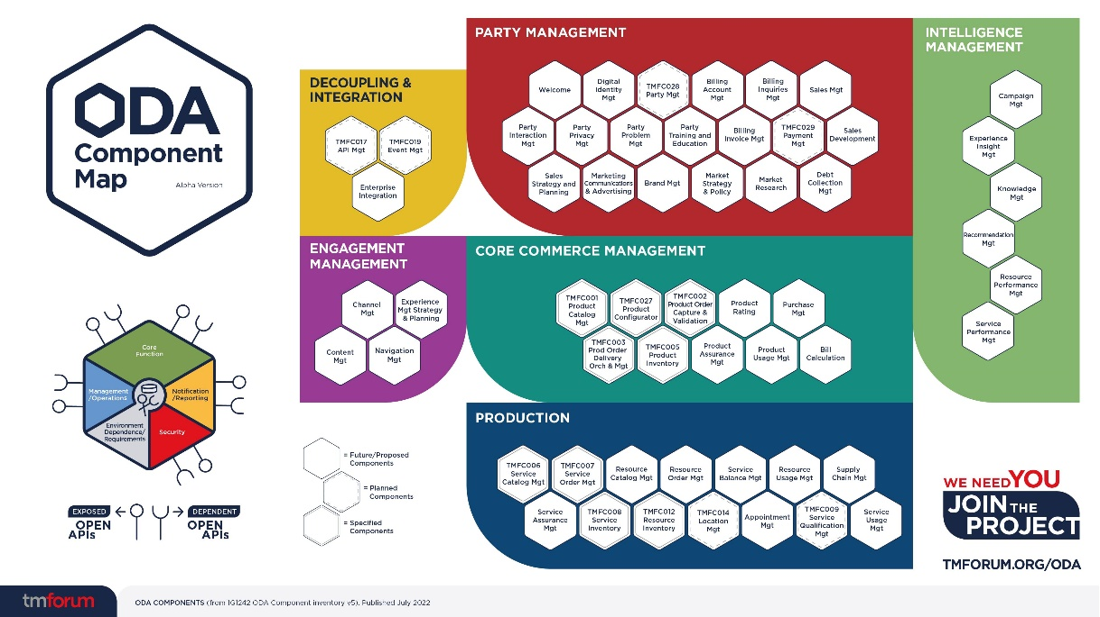
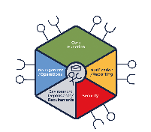
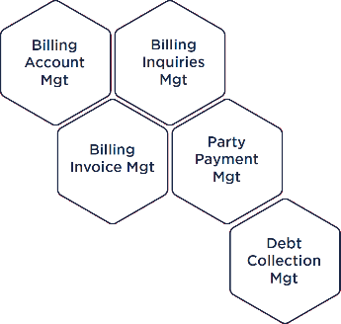
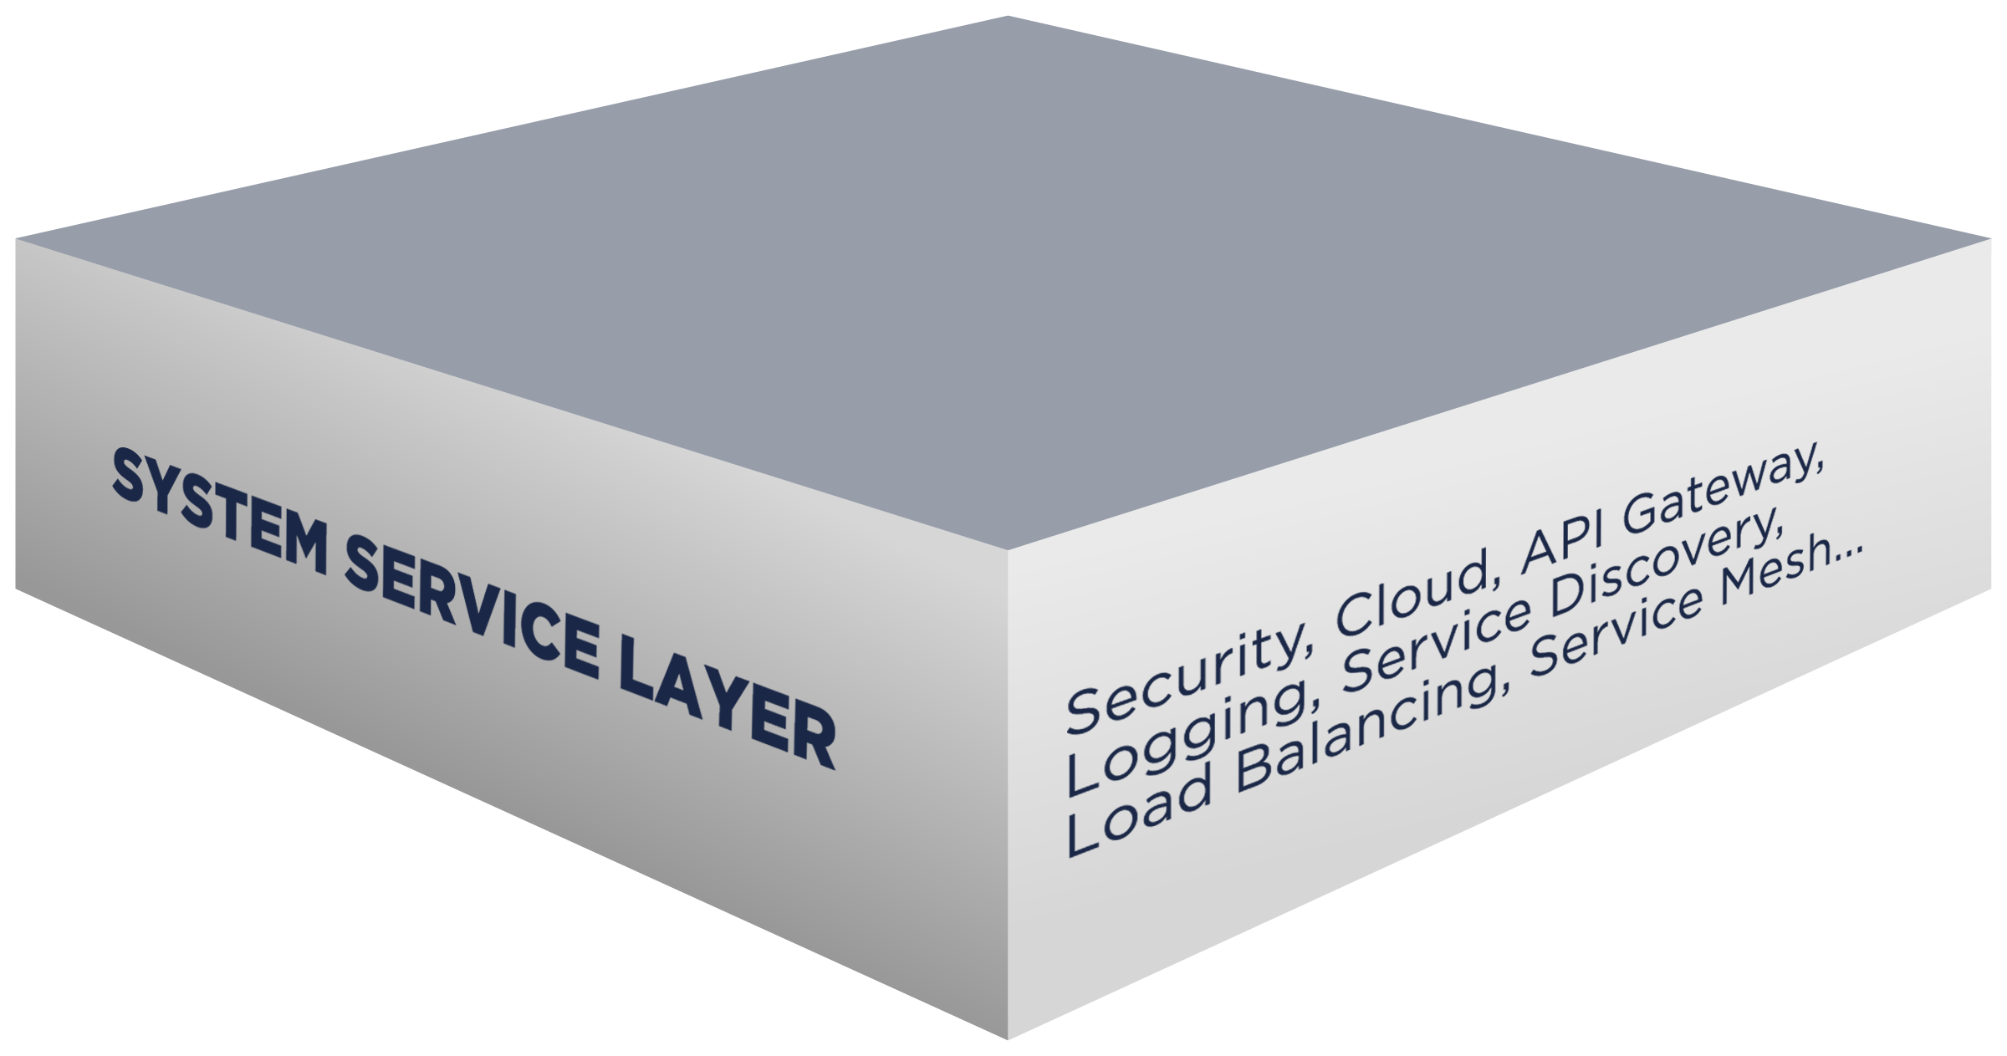

What is an ODA Component?
What is the ODA Canvas?
Vendor with ODA compliant components
ODA Canvas
OSS
BSS
CSP’s “ODA compliant” deployment environment
Components enable solutions to be built easily and quickly from a set of plug and play “Lego blocks”.
Connected using Open APIs and based on a standard data model.
Delivering agility, flexibility and scalability. Strengthening and simplifying the procurement process.
This is made possible by an operational Canvas, exposing standard services for monitoring, management, security, etc.
Delivering simplified operations and reducing total cost of ownership.
Notes:
A story in two halves – Components and Canvas
Components are the reusable building blocks, which can be used to build business solutions.
The interoperate using Open APIs and share a common data model, making plug and play a reality.
This is made possible by the ODA Canvas.
The ODA Canvas is an operational canvas which exposes standard services to all of the components.
This covers functionality such as monitoring, component management, identity management, etc.
A Canvas Example: Identity Management and authentication will be provided as a Canvas service. So, each individual component does not need to deal with identity management, but can utilise the identity management service provided by the canvas. From an operational point of view this means there is just one way of doing identify management, rather than each application having it’s own way of doing things. When this principle is applied across all the common canvas services it will result in the operational savings and TCO reduction.
(Note: The following slides repeat this message, but allow you to go into more detail if required.)

Slide 29
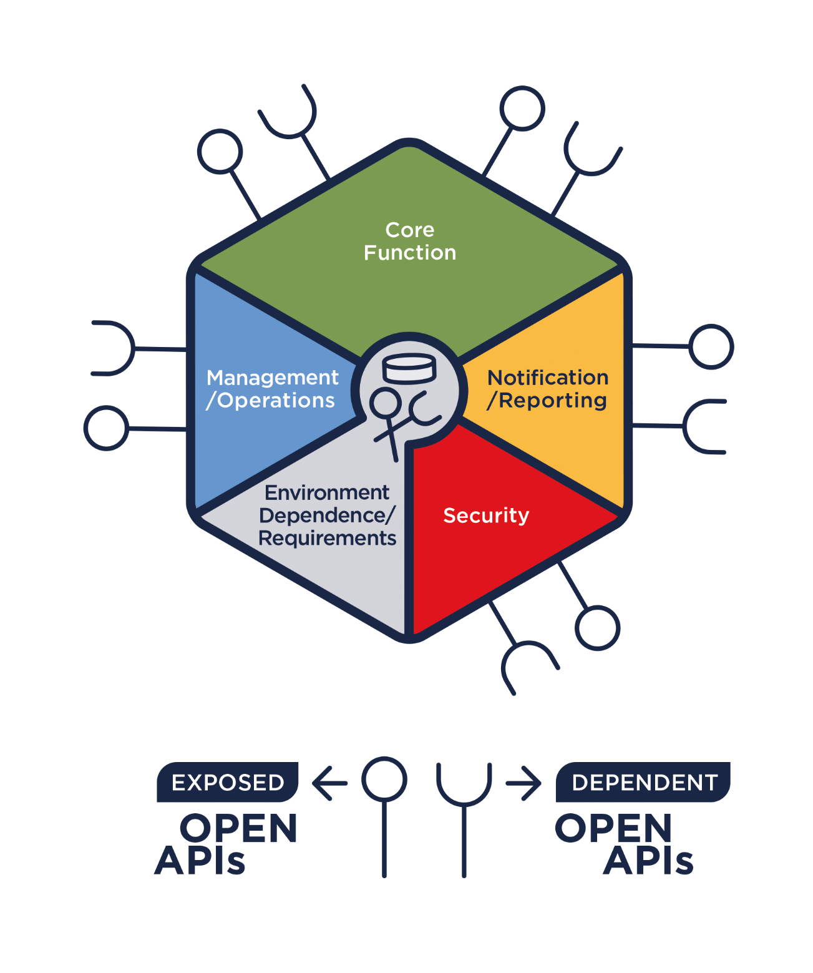
ODA Components
ODA specifies standardized, reusable software-defined components connected via Open APIs
Support real time, dynamic integration via TM Forum Open APIs (components can be assembled like Lego blocks - Open APIs and a standard data model enable zero-touch interoperability)
Expose their business capabilities (discoverable via Catalogs) externally through Open APIs, enabling zero-touch partnering
Support a common data architecture; contain their own data and share it in real-time (AI-ready)
Components are microservices-based, supporting cloud native deployment (eg autonomous, self-healing, self-scaling…)
Can be automatically deployed and managed in an operational ‘Canvas’, exposing operational interfaces for management, monitoring, security…

Slide 30
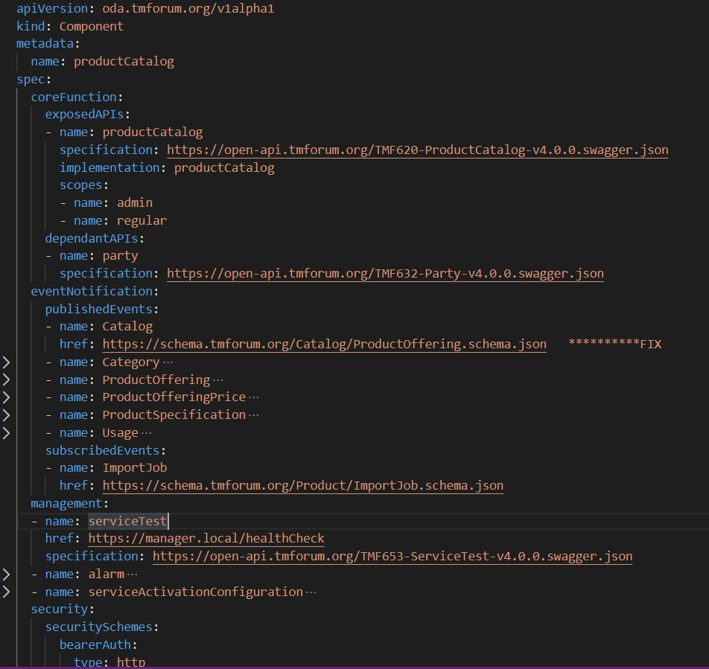

What is an ODA Component?
An ODA Component describes itself via its “Envelope” (YAML definition)
ODA comprises reusable, cloud native software components organized into loosely coupled domains
1
1
2
5
2
4
3
3
4
5

Slide 31


Slide 32
Open Digital Architecture – Reference Implementation | Canvas
The ODA Canvas consists of the Release Automation part of a CI/CD pipeline as well as an Execution Environment (ODL)
CI/CD Build
CI/CD Release
Canvas consists of the Release Automation part of a CI/CD pipeline
As well as an Execution Environment
Test Automation
Release Automation
API Gateway
Runtime Environment (Kubernetes)
Service Registry
Load Balancing
Logging
License Manager
Service Discovery
ODA Canvas
Execution Environment
Service Mesh
Authorization
Event Hub

Slide 33
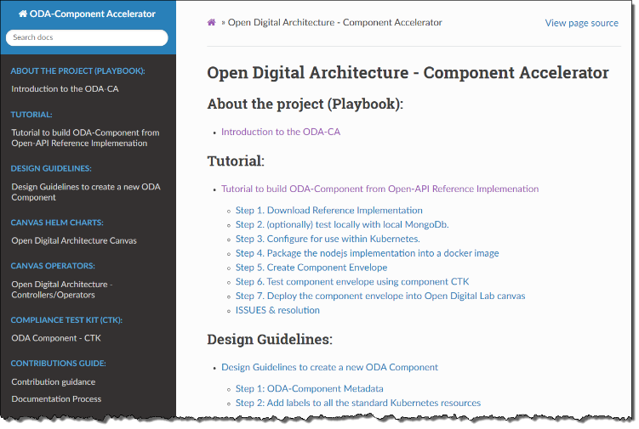
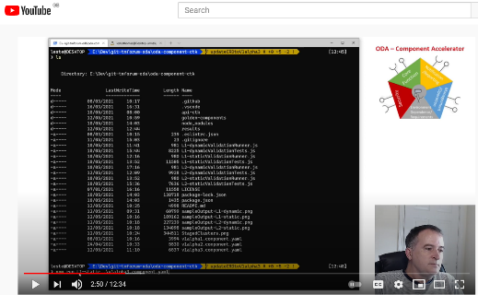
ODA Public Resources
Open Digital Architecture collaboration project
IG1245 Principles to Define ODA Components
IG1222 ODA Technical Architecture Overview
IG1242 ODA Component Inventory
TMFC001: Product Catalog Management component spec
IG1228 End-to-end Use Cases
ODA-Component Accelerator Project Documentation
Playbook and tutorials (here’s a video on how to use it)
ODA-Component Accelerator show & tell videos
Component CTK demo
Security validation of ODA Components
ODA Canvas and Component Observability
Project introduction
Email accelerator@tmforum.org for more information

Slide 34
Towards Conformance Certification for ODA Components
Andy Tiller
EVP Products & Services
June 2022

Slide 35
Towards Conformance Certification for ODA Components

Slide 36
The ODA Journey
Our whole industry will benefit from ODA
Plug-&-play IT & Networks will accelerate concept to cash and eliminate integration overheads
Autonomous Operations will reduce OpEx and improve customer experience
Open integration with ecosystem partners will deliver growth Beyond Connectivity
…but only if the whole industry moves forward together
We need to ‘go cloud-native’ together, adopting the same standards and deployment practices
Our industry is on a collaborative journey to build and adopt the ODA standards
Both the specs and real-world deployments are at an early stage in the journey
Commercial products and real-world deployments will move gradually towards ODA conformance
Vendors migrate their commercial products towards compliance with ODA Components
CSPs migrate their deployment environments towards compliance with the ODA Canvas
It will take time for vendors and CSPs to evolve to this model; in the meantime, there are steps which both vendors and CSPs can take towards the vision

Slide 37
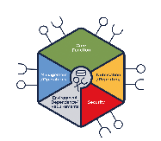
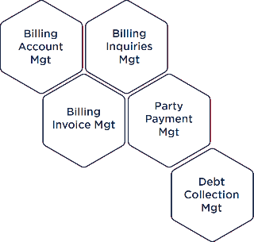
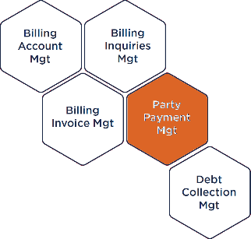
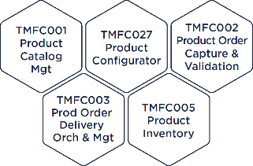
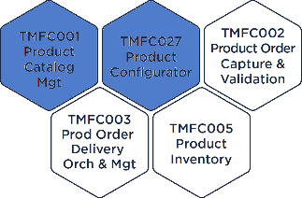
Steps to ODA Component Conformance
2022: Level 1
2022-23: Level 2
Future
ODA Canvas
ODA Canvas
Functional mapping & Open APIs
The functional scope of commercial products is mapped to the ODA Component inventory and the Open APIs required by the components are supported at the external boundary. The ODA Component inventory replaces TAM as a reference for software procurement.
Cloud native deployment
Microservices based components are deployable as cloud native applications on the ODA Canvas. Interoperability between cloud native applications from different suppliers is verified in end-to-end use case demonstrations.
Fully conformant ODA Components
Commercial products comprise fully compliant (and certified) ODA Components which can be procured and deployed individually and independently

Slide 38
Roadmap to ODA Component Conformance
Baseline
TAM Replacement
Vendors map their commercial products to ODA Components poster
Level 1
Open API Conformant
Certification of exposed Open APIs for each component
Level 2
Canvas Ready
Vendors deploy containerized products onto the reference Canvas in the Open Digital Lab
Level 3
Full Conformance
Products comprise independently deployable, certified ODA Components
Prototype at DTW 2022
Prototype in Feb-23
Prototypes later in 2023

Slide 39
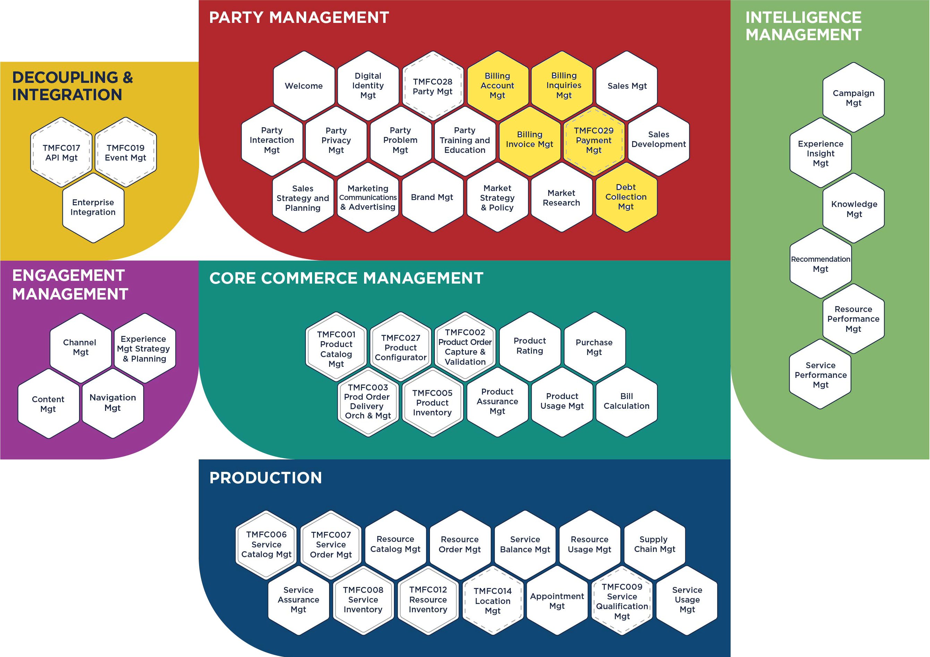
Functional mapping & Open API conformance (2022)
Scope mapping
CSPs use the ODA Component inventory* to scope procurement requests, and vendors map their commercial applications to it
Level 1: API conformance
CSPs mandate / reward Open API conformance, and vendors undergo certification for the Open APIs within their commercial products
Commercial products usually correspond to “ODA Systems” (typically covering the functional scope of several components)
The ODA Component specifications define the functional scope of any ODA System and the Open APIs it must support
Example commercial product comprising five ODA Components (an ODA System)
* IG1242
ODA Component Directory
TM Forum provides an online directory with tools for vendors to self-declare their mappings and CSPs to find the applications they want to procure. A prototype with real vendor data was released in September 2022.
Open API Conformance Certification
TM Forum provides CTKs and conformance certification for Open APIs, with tier badges and marketing benefits for compliance. 50+ companies have certified Open APIs. Level 1 API Conformance will be visible in the ODA Component Directory in early 2023

Slide 40
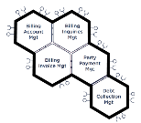
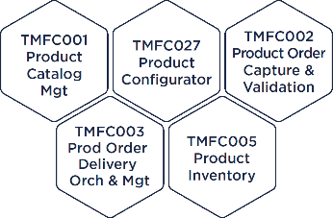
Cloud native deployment on the ODA Canvas (2023)
Level 2: Cloud-ready applications
CSPs deploy their own ODA Canvas environment, and vendors design microservices based cloud native applications that can run on it
Interoperable applications
CSPs and vendors verify interoperability of their applications using the ODA Canvas for end-to-end use case demonstrations
CI/CD Release
ODA Canvas
ODA Canvas
The ODA Canvas comprises the execution environment as well as the release automation part of a CI/CD
API Gateway
Runtime Environment (eg Kubernetes)
Service Registry
Load Balancing
Logging
License Manager
Service Discovery
Service Mesh
Authorization
Event Hub
Open Digital Lab
TM Forum provides a reference ODA Canvas and Open Digital Lab (ODL) environment where members can deploy containerized applications. The ODA-CA project has built an opensource ODA Canvas and prototype CTK.
ODA Reference Implementation
TM Forum is building an ODA Reference Implementation on the Canvas in the Open Digital Lab, which can be used as a platform for testing end-to-end use cases. Several Catalysts have demonstrated end-to-end use cases in the lab.

Slide 41
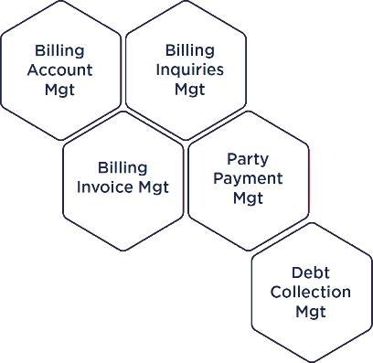
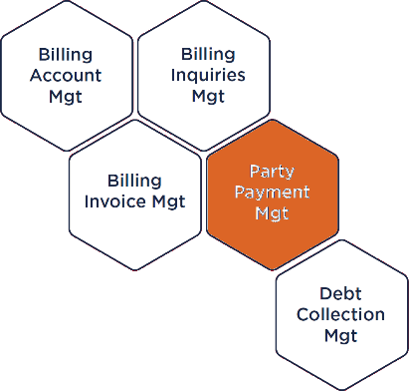
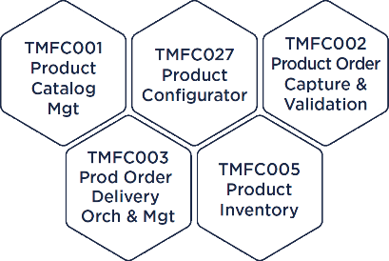

Fully conformant ODA Components (future)
Level 3: Swappable ODA Components
Commercial products comprise fully compliant ODA Components which can be procured and swapped individually and independently
In future, commercial products will be designed and built from reusable, composable, independently deployable ODA Components. We envisage a healthy market for ODA Components which benefits CSPs, vendors and systems integrators alike.
ODA Component conformance certification & test platform
The Open Digital Lab will support a test environment for ODA Components and provide component CTKs. In future, TM Forum will provide a conformance certification service for ODA Components, similar to today’s Open API conformance certification program. ODA Component (and Canvas) testing and conformance are active areas of development in the ODA project.

Slide 42
Why the ODA Components vision is good for software vendors and SIs
All Suppliers
Deployment is simpler, because each CSP has a similar execution environment based on a standardized ODA Canvas, and common deployment patterns
Standardized components eliminate the need for expensive maintenance of customized code branches for different customers, freeing developer resource to code high-value differentiating features
CSPs have more money to spend on new software and differentiating features because they are spending less servicing their legacy technical debt
The procurement process is simplified, reducing time and cost for all parties
Larger Vendors & SIs
It becomes easier to design and build the optimal solution architecture for each customer, using a combination of your own and your partners’ software products
It becomes simpler to integrate products from new partners and/or new mergers & acquisitions into your end-to-end product portfolio
Business becomes more profitable, shifting from low-value maintenance and integration services to high-value delivery of new and advanced capabilities
Faster project delivery reduces the risk of penalty clauses and increases the chance of earning on-time delivery bonuses
Smaller Vendors
Barriers to entry into new accounts are lowered, as CSPs see opportunities to introduce individual components with differentiating features
Deploying your solution no longer depends on incumbent suppliers playing ball, or require detailed historic knowledge of the customer’s IT environment and complex integration with legacy systems
More developer time can be assigned to differentiating features because security, observability and other generic services are provided by the ODA Canvas and no longer need to be coded separately in every component

